Slide 1
IMS Project
Ali Khattab – 21SepSoftware

Slide 2
Introduction
Who am I?
Brief: Design and build an Inventory Management System (IMS) for a store
How did I approach the specification?

Slide 3








Consultant Journey
Technologies learned for this project:

Slide 4
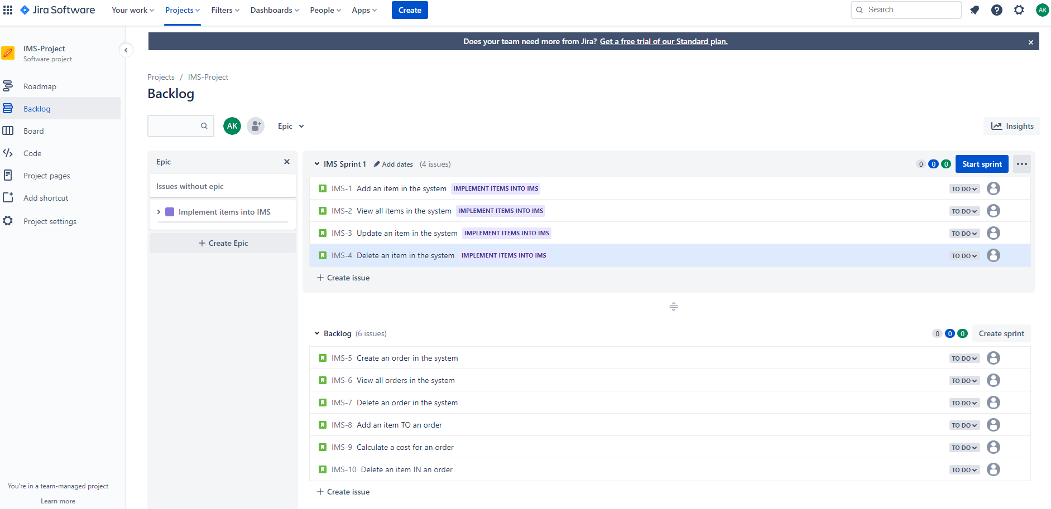
Jira

Slide 5
Continuous Integration
Version Control System – Git
Cloud-based hosting service – GitHub
Smart commits from GitHub linking to Jira

Slide 6
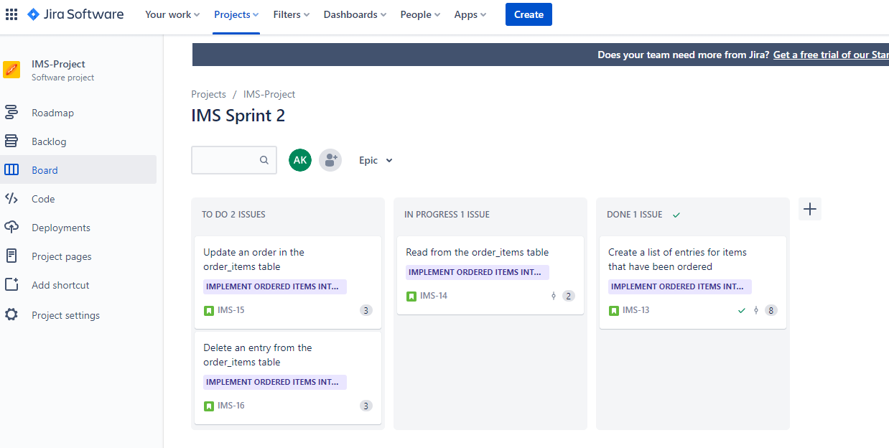
Jira Sprint

Slide 7
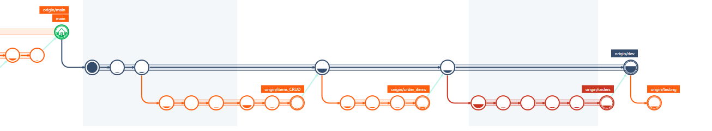
GMaster
Feature Branch Model

Slide 8
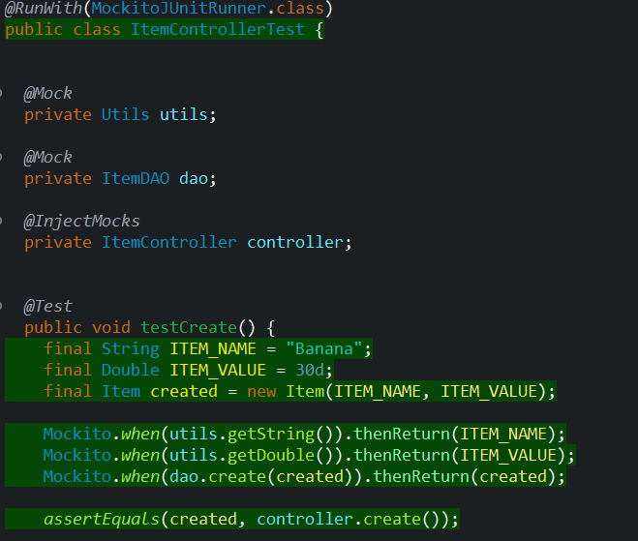
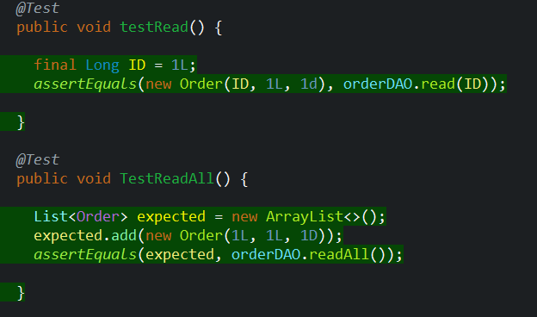
Testing

Slide 9
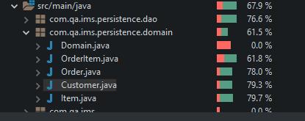
Testing Coverage

Slide 10
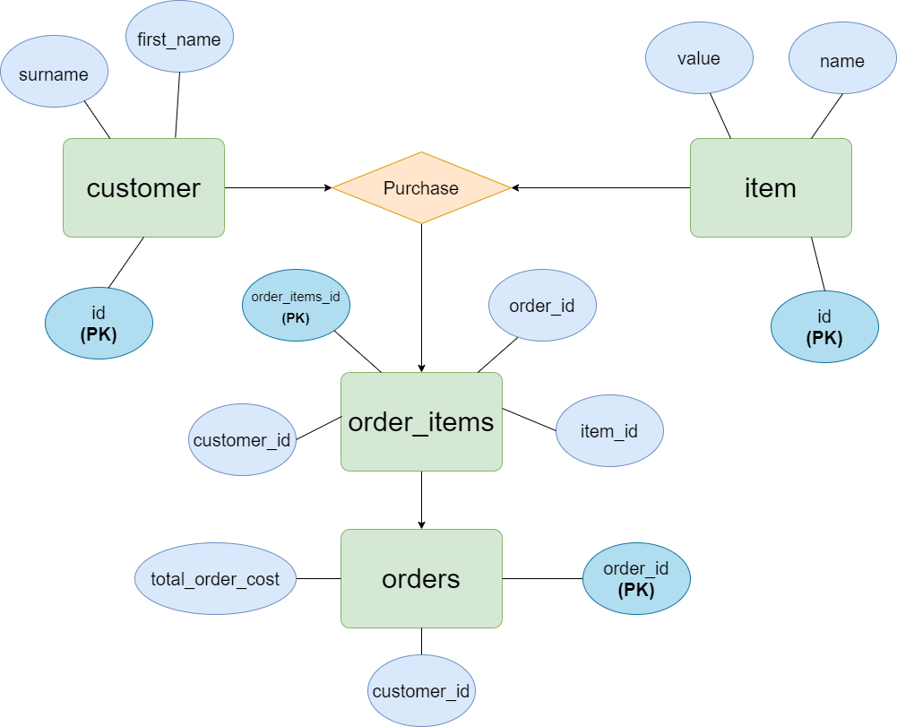
Entity Relationship diagram

Slide 11
Entity Relationship diagram
order_item_id | order_id | customer_id | item_id
1 | 1 | 9 | 3
2 | 1 | 9 | 4
3 | 1 | 9 | 4
4 | 1 | 9 | 6
5 | 2 | 4 | 8
6 | 2 | 4 | 4
order_id | customer_id | total_cost
1 | 9 | 17.0
2 | 4 | 12.0

Slide 12
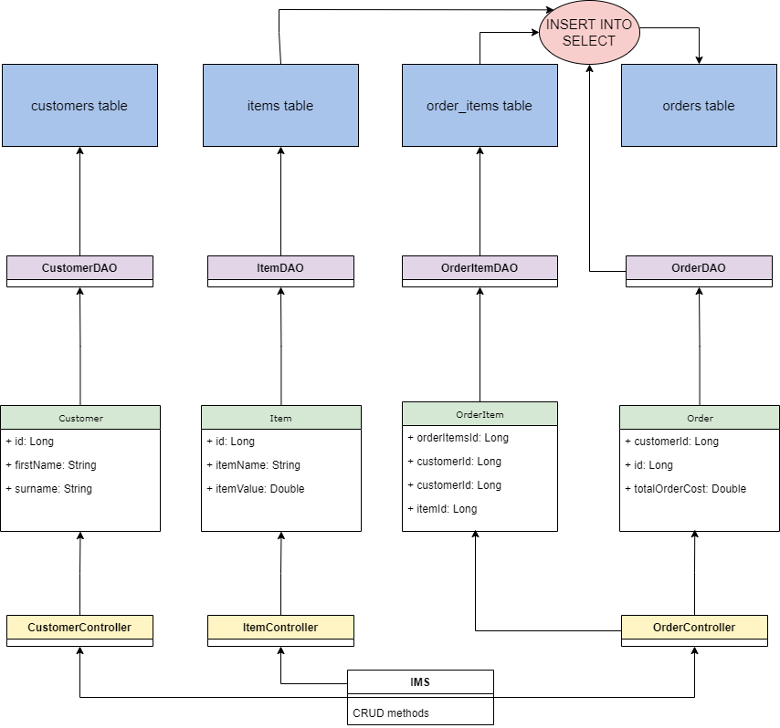
UML Diagram

Slide 13
Demonstrations

Slide 14
Sprint Review
What did I complete
What got left behind

Slide 15
Sprint retrospective
What went well?
What could be improved?

Slide 16
Conclusion
Questions?
GitHub: https://github.com/aliktb/IMS-Starter
Jira: https://emaplejiralxc1.atlassian.net/jira/software/projects/IMS/code

